Slide 1

SANT GADGE BABA AMRAVATI UNIVERSITY
Guide Name : Miss.Shweta Gulhane

Slide 2

IMPLEMENTATION OF STATISTICAL FUNCTION
By : Mayur Madadhe

Slide 3

INTRODUCTION
TOOLS & LANGUAGE
PROJECT DESCRIPTION
RESULT
CONCLUSION
FUTURE SCOPE
REFERENCE

Slide 4

INTRODUCTION
Statistical functions apply a mathematical process to a group of cells in a worksheet. The goal of statistical analysis is to identify trends.
A retail business, for example, might use statistical analysis to find patterns in unstructured and semi-structured customer data that can be used to create a more positive customer experience and increase sales.

Slide 5
TOOLS & LANGUAGE
In given program we used a JAVA language to built an Backend and APACHE netbeans tool to Provide an Frontend to successful execution of a project.
Java is a class-based, object-oriented programming language and is designed to have as few implementation dependencies as possible.
Apache NetBeans is much more than a text editor. It highlights source code syntactically and semantically.

Slide 6
PROJECT DESCRIPTION
Statistical functions apply a mathematical process to a group of cells in a worksheet. The goal of statistical analysis is to identify trends.
In the given project there are some statistical functions are as:
AVERAGE
AVEDEV
AVERAGEA
AVERAGEIF
AVERAGEIFS

Slide 7
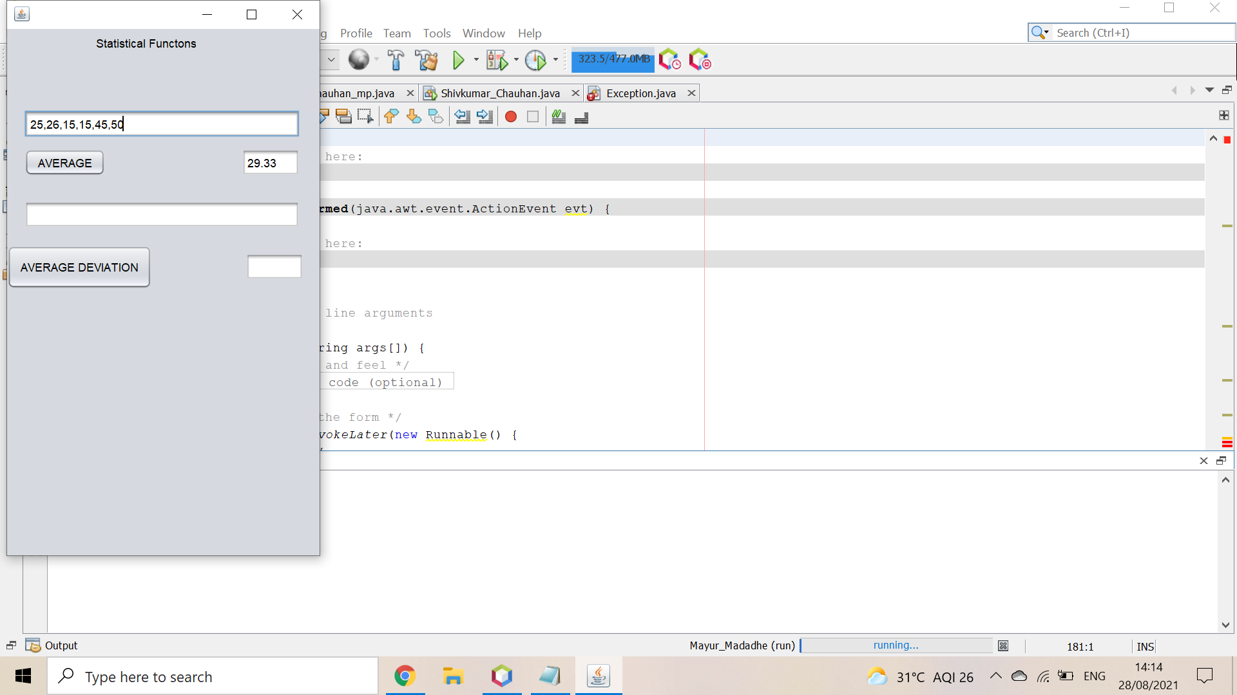
RESULTS:
AVERAGE returns the average of the given numbers. It also called as Mean .

Slide 8
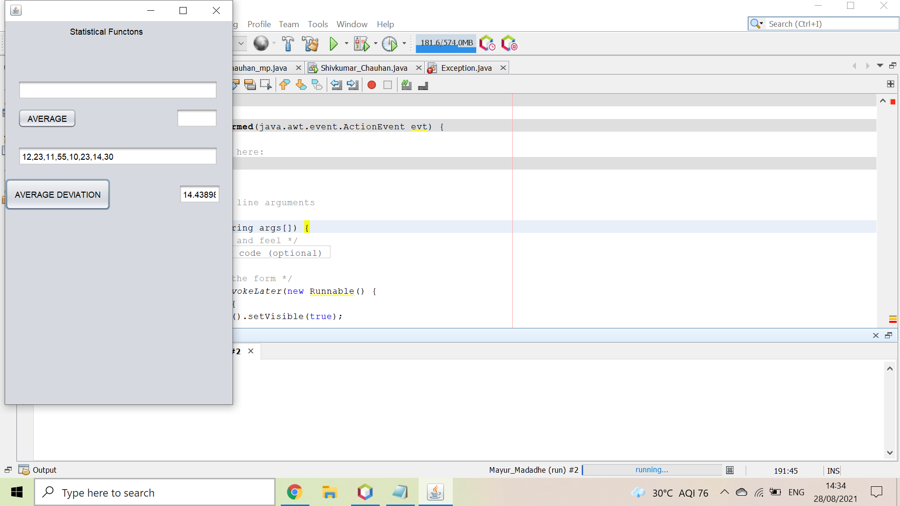
reSULTS
Average Deviation calculates the Standard Deviation of the given elements.
For Average Deviation first we should calculate Average and then Standard Deviation. It is also called as Mean Deviation.

Slide 9
CONCLUSION
We successfully designed and implemented a mini project on Implementation on Statistical Functions, that allows direct interaction with our system.
In Statistical functions there are too many aspects many of functions like AVERAGE, AVERAGEA, AVEDEV,AVERAGEIF,AVERAGEIFS in Statistical Functions

Slide 10
FUTURE SCOPE
Sales Forecasts
Forecasting
To Present Facts in Definite Form
Economy
Comparisons
Bussiness
Medical statistics

Slide 11
REFERENCE
http://www.github.com
https://1000projects.org//
http://www.tutorialpoint.com
http://www.tutorialkart.com
https://www.analyticsvidhya.com

Slide 12


